Slide 1
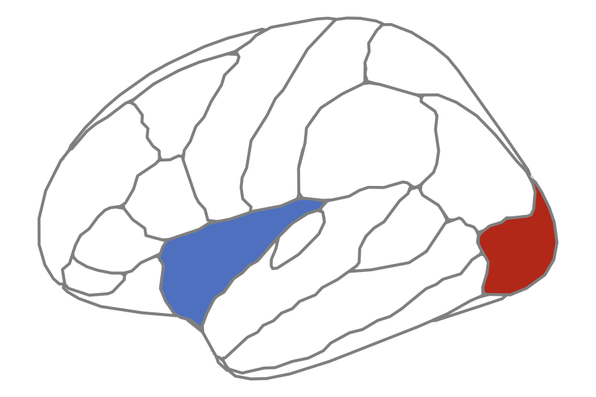
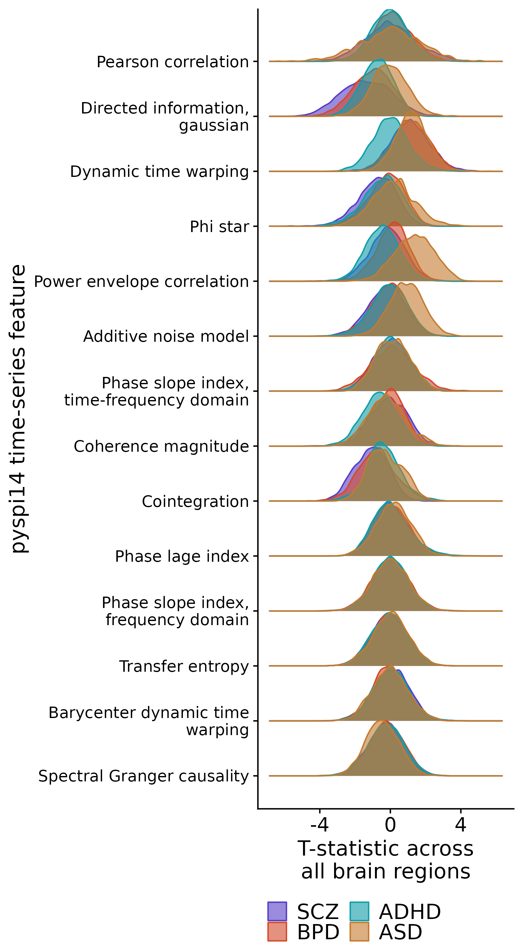

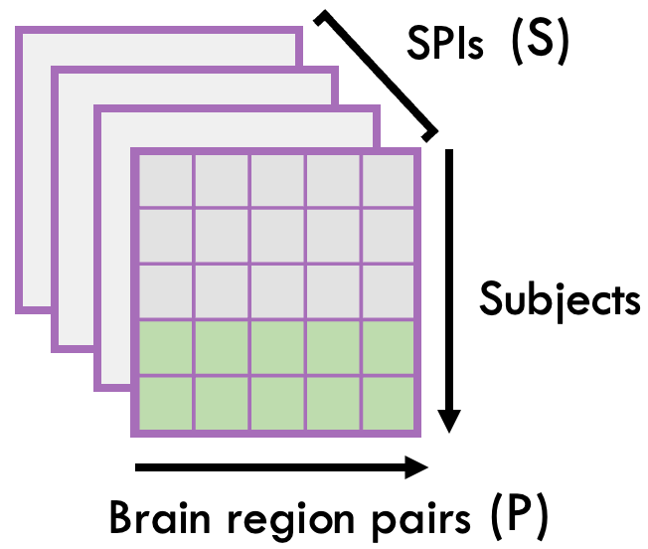

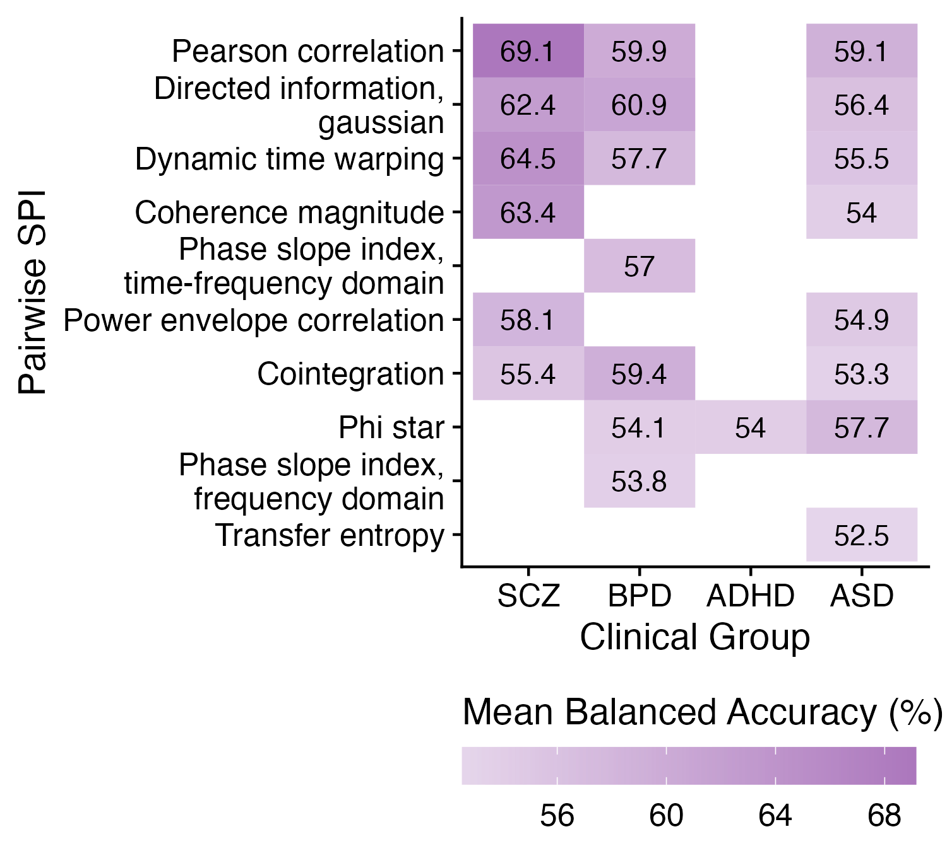
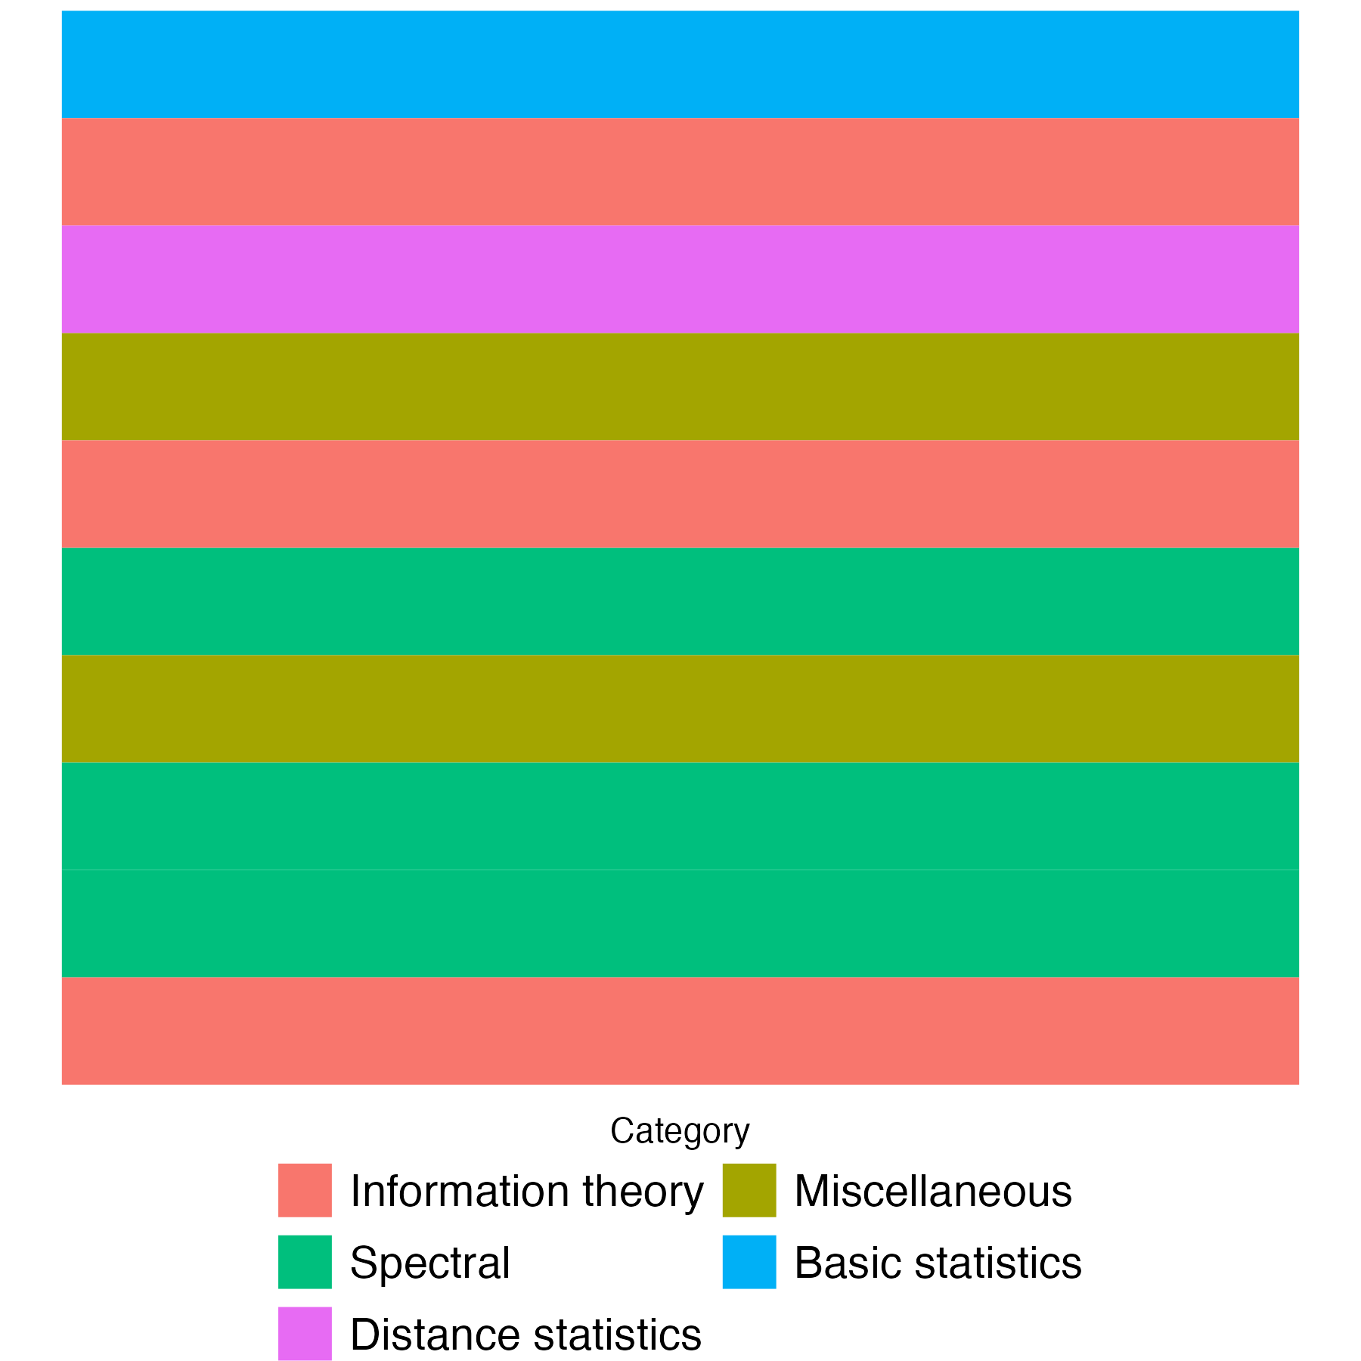
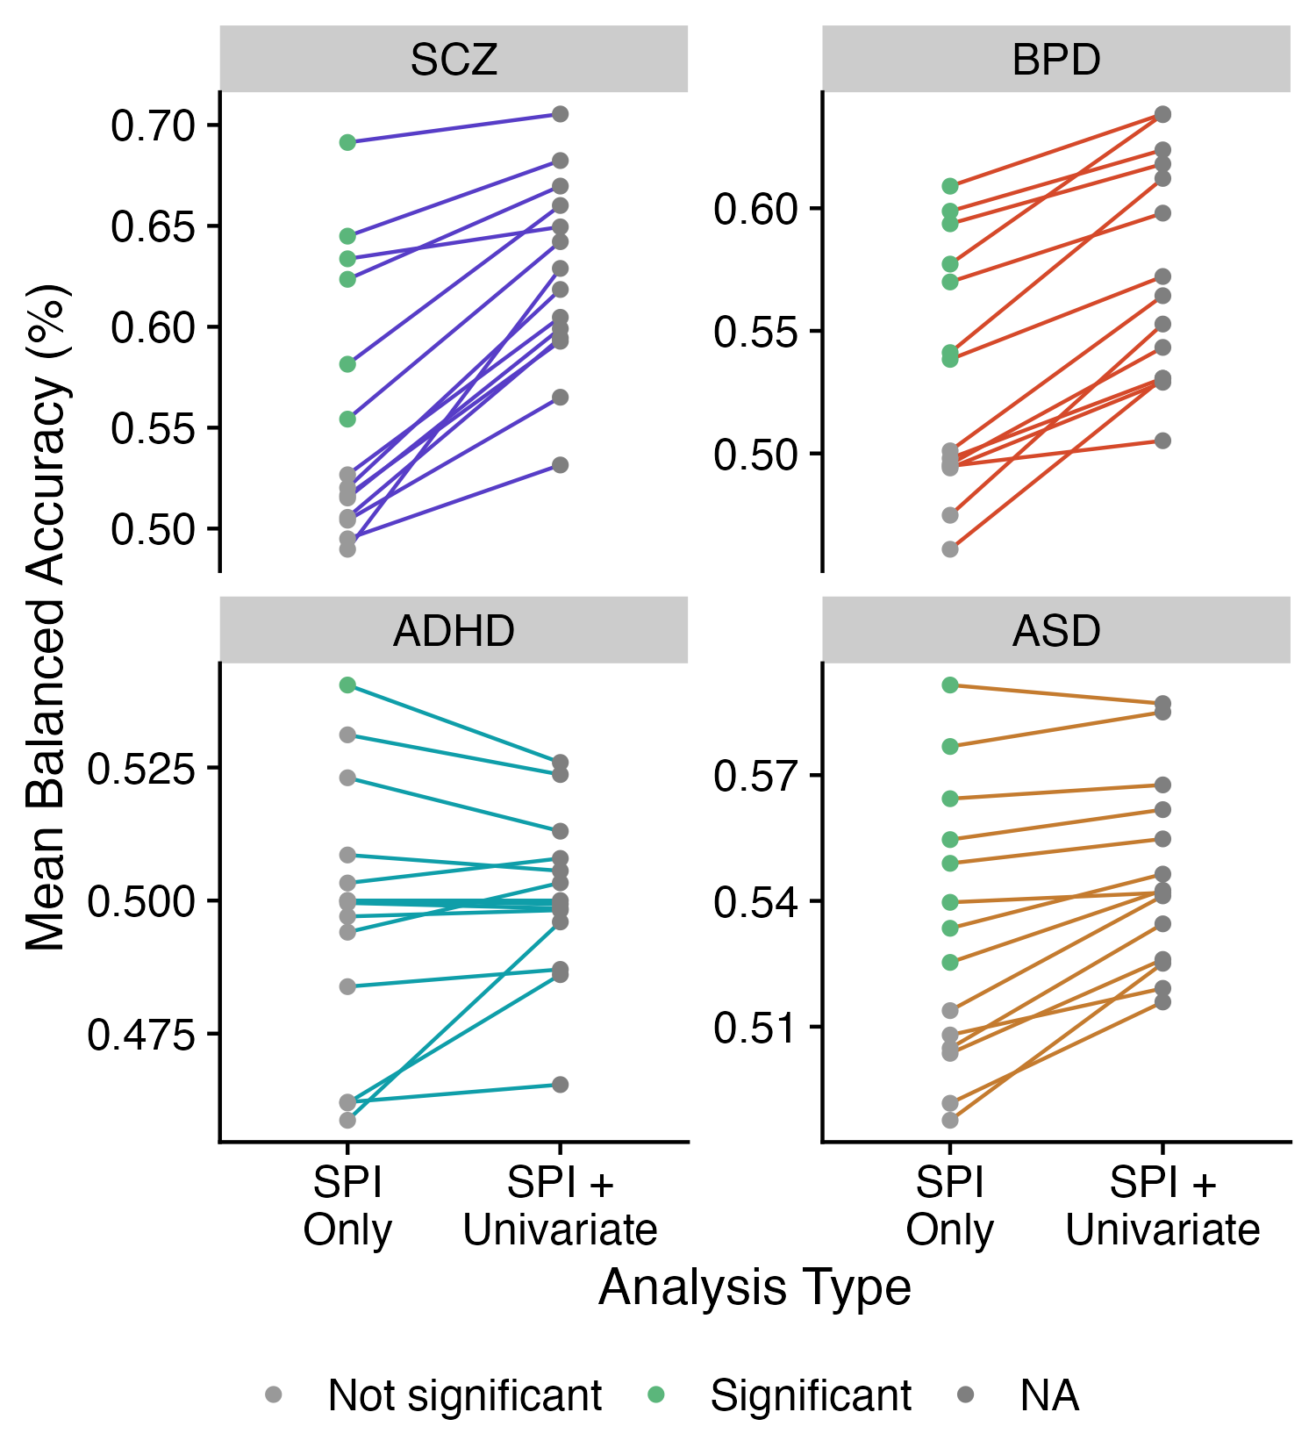
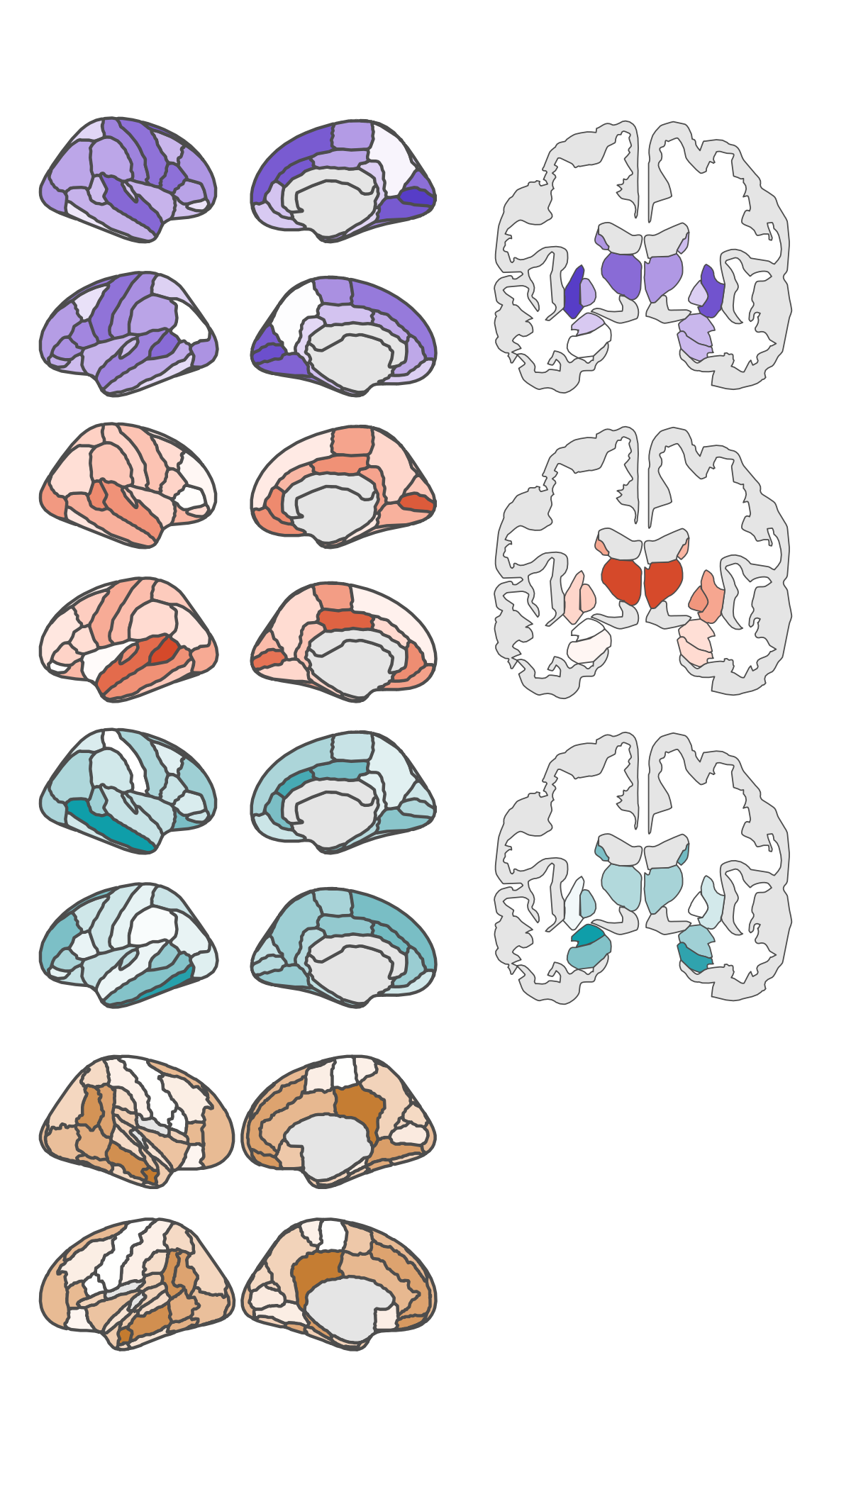
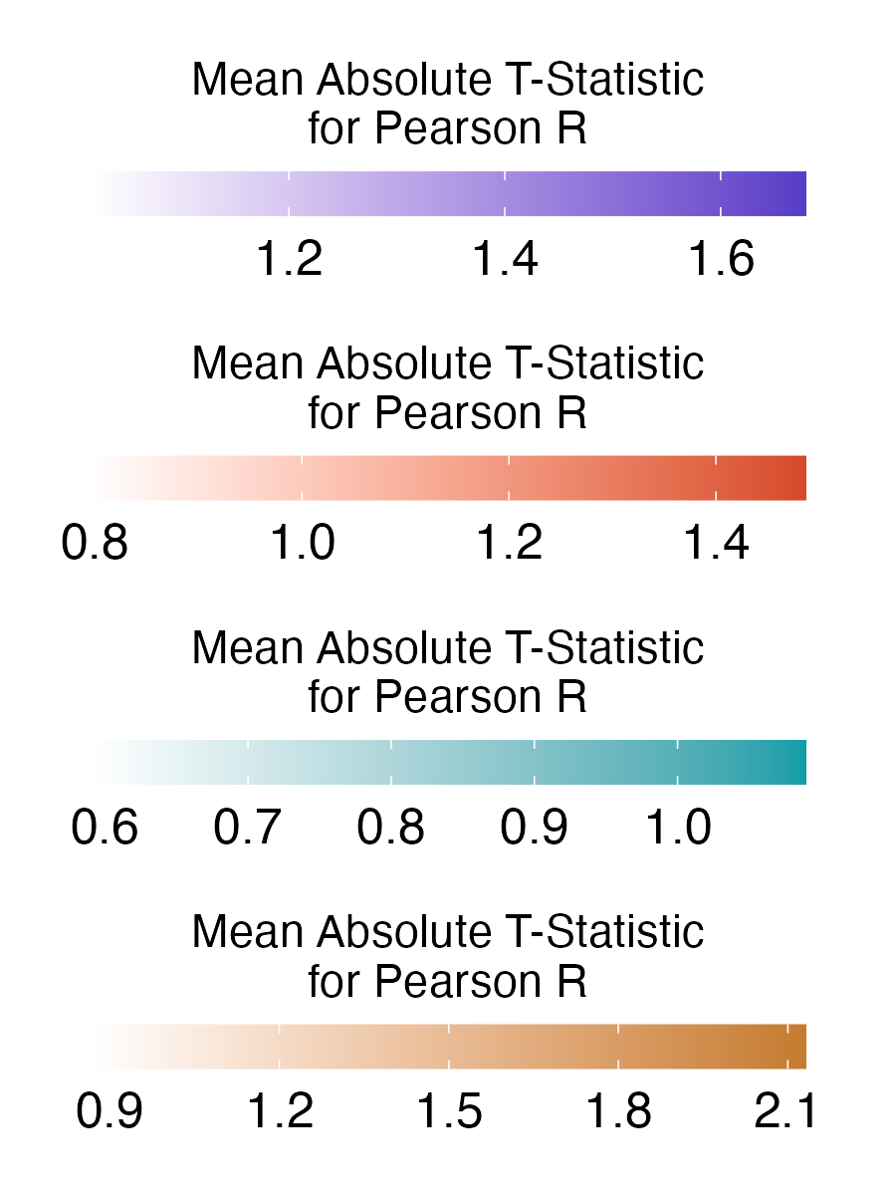


A
D
SPI 1
SPI 1
Repeat for all 14 SPIs
SPIs
Linear SVM
B
C
Color based on if there’s a significant differences with corrected t-stat
E
SCZ
BPD
ADHD
ASD
Notes:
Figure 2. Univariate classification results for ASD and schizophrenia. A: Results from region-based classification analysis. For ASD, the bilateral superior frontal gyrus yielded a statistically significant balanced accuracy (55.95 +/- 0.52, p=4.58e-04, BH-adjusted p=2.20e-02). For schizophrenia, the all yielded significant balanced classification accuracies. right postcentral gyrus (67.23 +/- 2.49, p=1.00e-03, BH-adjusted p=4.07e-02), right amygdala (66.82 +/- 2.12, p=1.32e-03, BH-adjusted p=4.07e-02), and left banks of the superior temporal sulcus (66.64 +/- 1.97, p=1.49e-03, BH-adjusted p=4.07e-02)

Slide 2
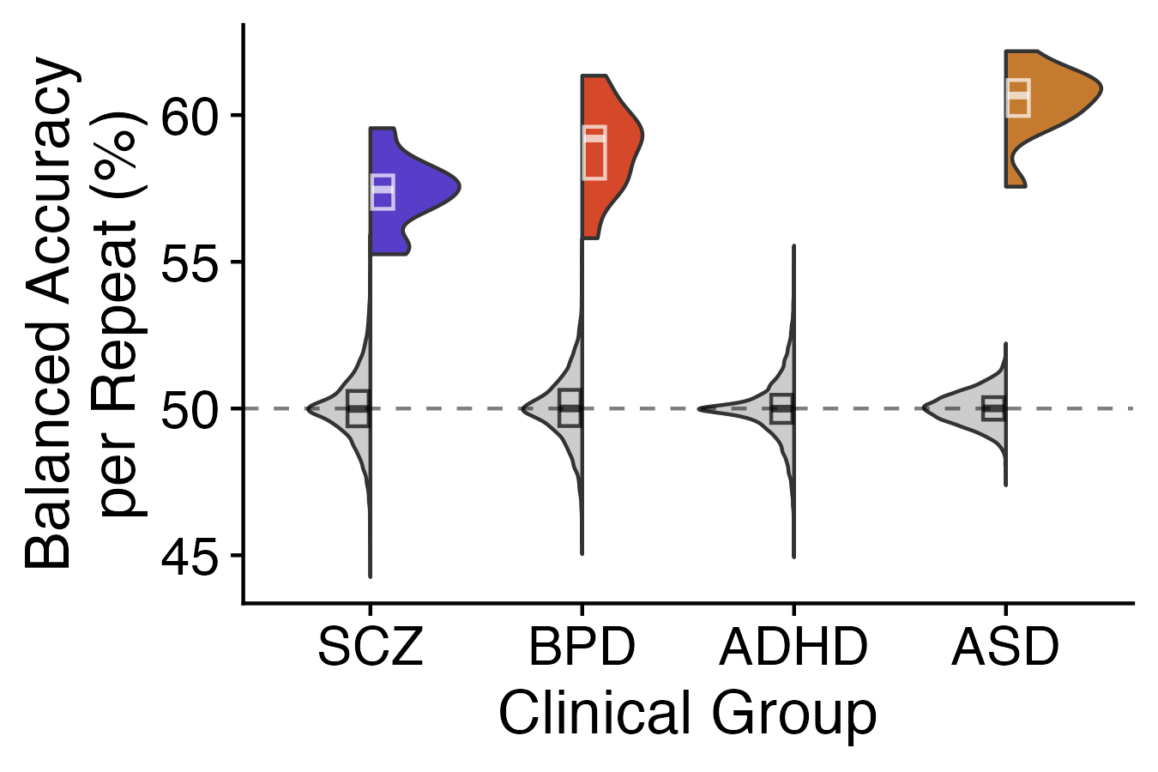

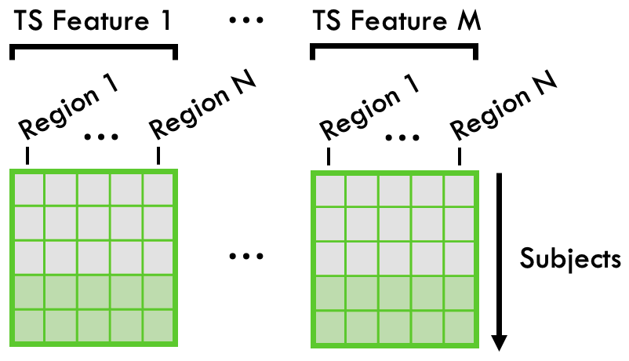
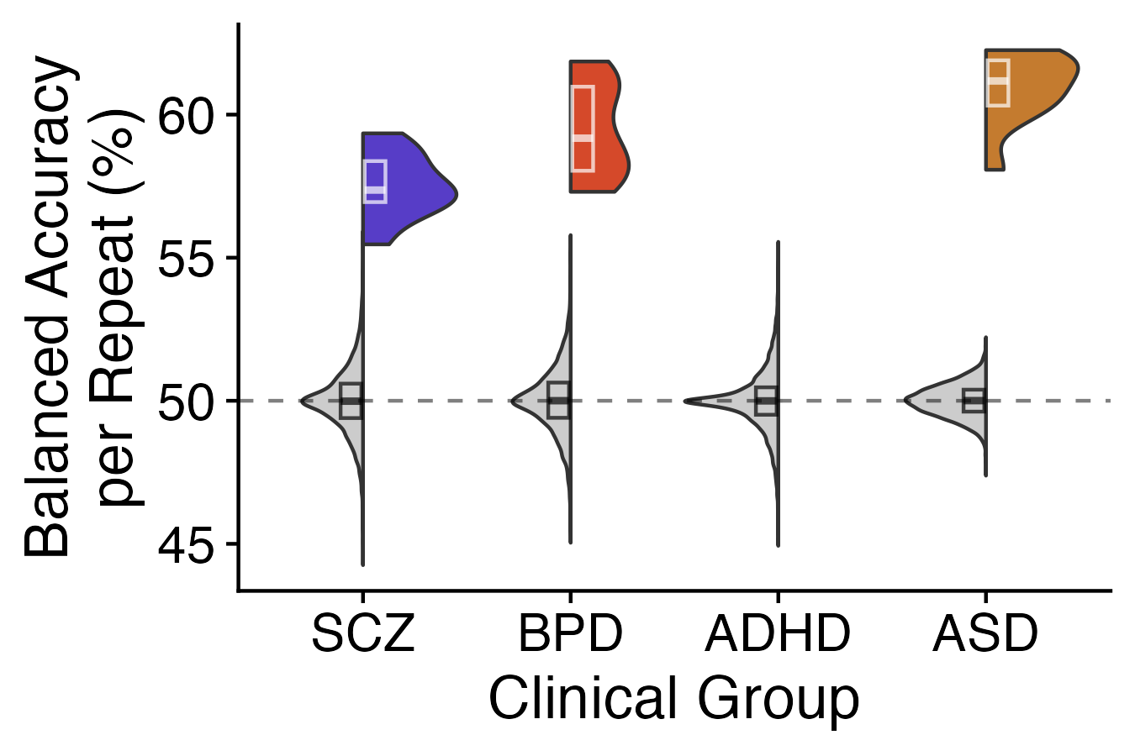

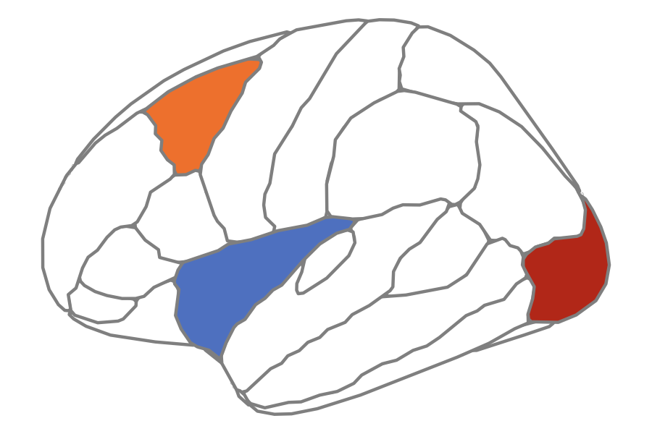





A
B
SPIs
Linear SVM
C
D
Don’t have p-values yet, should I run nulls for this or nah?
Features
Compute 24 univariate BOLD rs-fMRI TS features
Linear SVM
Compute 14 pairwise BOLD rs-fMRI SPIs
SPIs
Notes:
Figure 2. Univariate classification results for ASD and schizophrenia. A: Results from region-based classification analysis. For ASD, the bilateral superior frontal gyrus yielded a statistically significant balanced accuracy (55.95 +/- 0.52, p=4.58e-04, BH-adjusted p=2.20e-02). For schizophrenia, the all yielded significant balanced classification accuracies. right postcentral gyrus (67.23 +/- 2.49, p=1.00e-03, BH-adjusted p=4.07e-02), right amygdala (66.82 +/- 2.12, p=1.32e-03, BH-adjusted p=4.07e-02), and left banks of the superior temporal sulcus (66.64 +/- 1.97, p=1.49e-03, BH-adjusted p=4.07e-02)

Slide 3
***
***
***
C
Collapse into summary statistics of hypo vs. hyperconnected pathways in each condition (blue to red colored chord diagrams, outer circle colored by lobe/subcortex?)
Notes:
Figure 2. Univariate classification results for ASD and schizophrenia. A: Results from region-based classification analysis. For ASD, the bilateral superior frontal gyrus yielded a statistically significant balanced accuracy (55.95 +/- 0.52, p=4.58e-04, BH-adjusted p=2.20e-02). For schizophrenia, the all yielded significant balanced classification accuracies. right postcentral gyrus (67.23 +/- 2.49, p=1.00e-03, BH-adjusted p=4.07e-02), right amygdala (66.82 +/- 2.12, p=1.32e-03, BH-adjusted p=4.07e-02), and left banks of the superior temporal sulcus (66.64 +/- 1.97, p=1.49e-03, BH-adjusted p=4.07e-02)

Slide 4
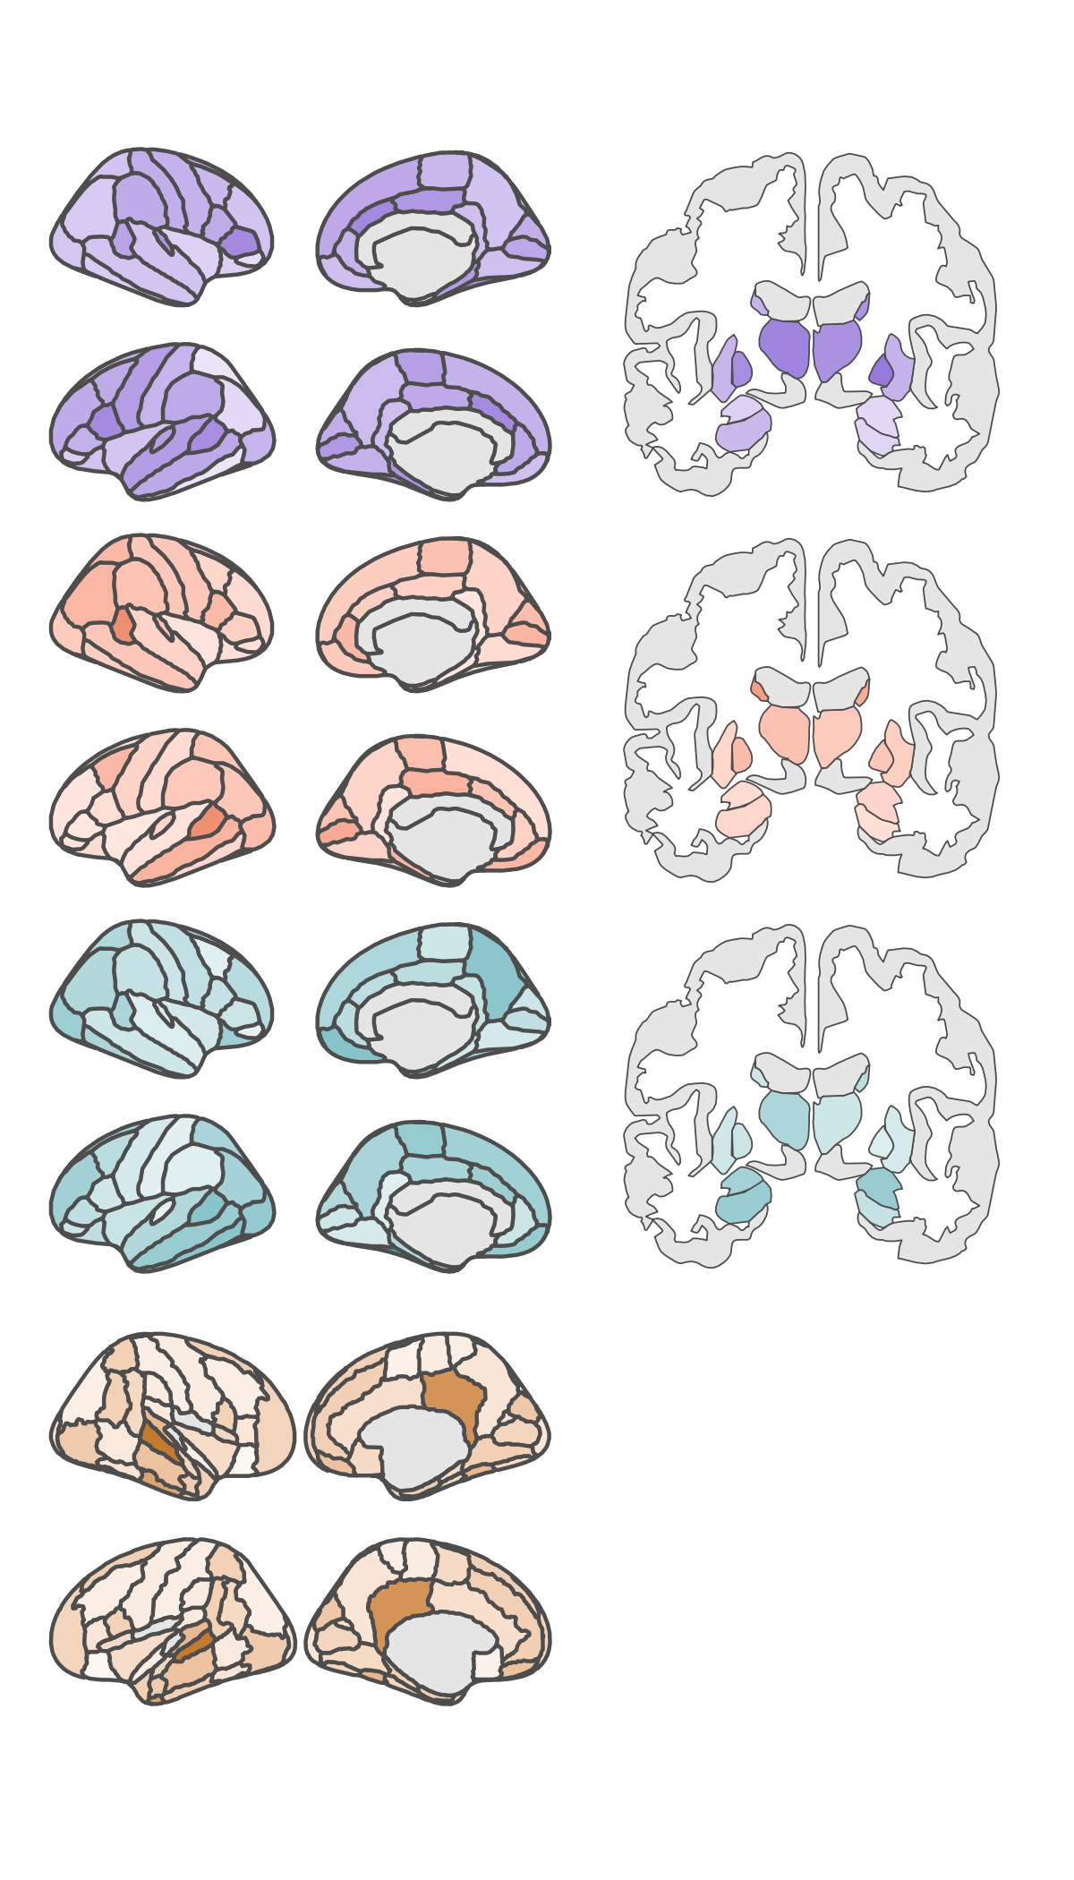
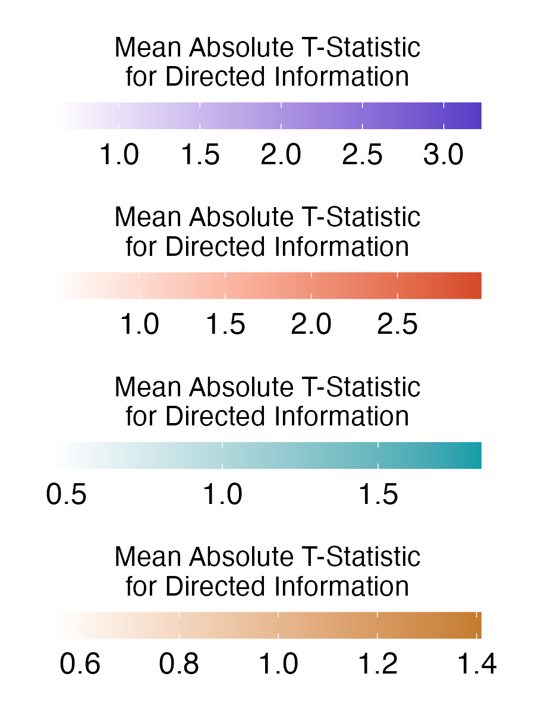
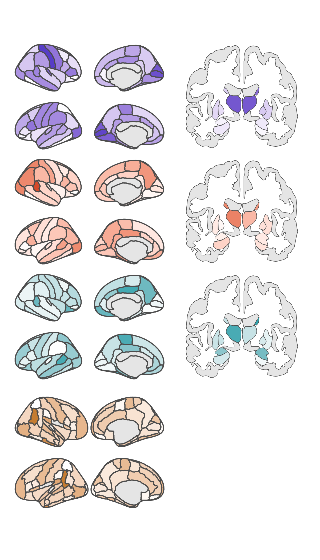
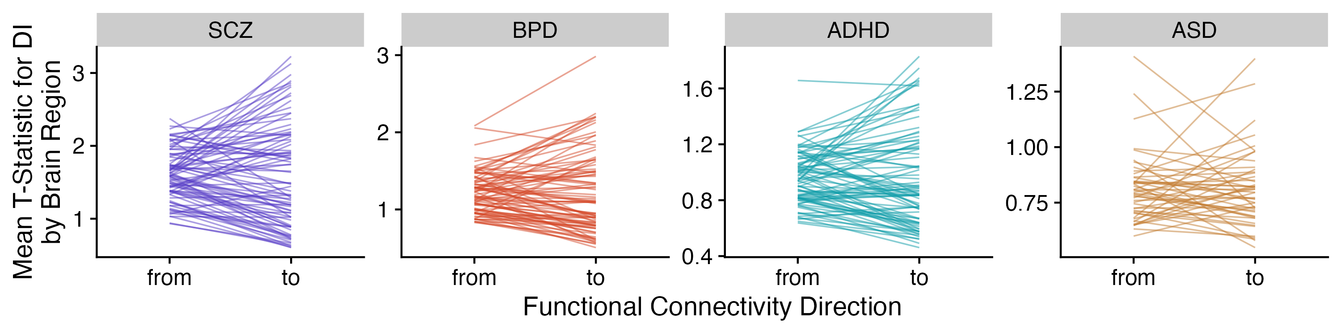
A
SCZ
BPD
ADHD
ASD
From each region
To each region
B

